Slide 1
Title: PDF Scanner And Reader
University Of Karachi
Department Of Computer Science
Group Members: Taimoor Qureshi,
Muhammad Anas,
Taha Alam,
Talha Mustafa.
Course Supervisor: Dr. Humera Tariq

Slide 2
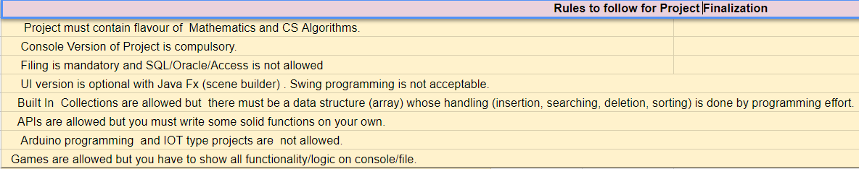
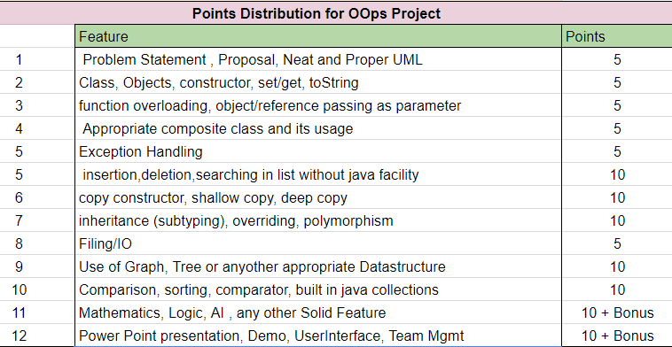

Slide 3
Contents
Introduction
Problem Statement
Why It is important to Solve the Chosen Problem?
Sample Input
Sample Output
Filing
UML Diagrams
UML of Main Class
UML Showing Association between Classes
UML Showing Composition between Classes
UML Showing Inheritance between Classes
UML Showing Filing
UML Showing Exceptions
Overall UML Diagram of System
Attributes Handling
Private
static
final
Code snippets of Constructor calling different types
Code Snippets of Copy
Shallow copy Concept
Deep Copy Concept
Code Snippets of Function Calling
Showing Object passing as parameter
Showing Object returns from function in class
Code Snippets of Overloading
Code Snippets of using arrays
Array of Objects
Polymorphic Array
ArrayList
Code Snippets of Overriding
Code Snippets of Type Casting and Boxing-unBoxing
Exceptions
Learning and achievements
Improvement and Future Work
Demo and Queries
Singleton Pattern (Bonus)
Composite Pattern( Bonus) Java Fx GUI (Bonus)
MVC Pattern (Compulsory)---Organizing your code into multiple folders namely Model, View and Controller

Slide 4
introduction
In this Section we described the chosen problem along with sample input and output.

Slide 5
Problem Statement
The objective of the project is to Pick several Image especially “Documents Images” and Convert them into Portable Document Format(PDF) file.
BSCS-415 Object Oriented Programming

Slide 6
Importance
To Solve the given Problem is important because this is era of technology and Data is now moving/transmitting on Electronic devices. So several pages Documents Image may lose their quality as well as Sequence that’s why it’s important to convert them into Portable Document Format(PDF).

Slide 7
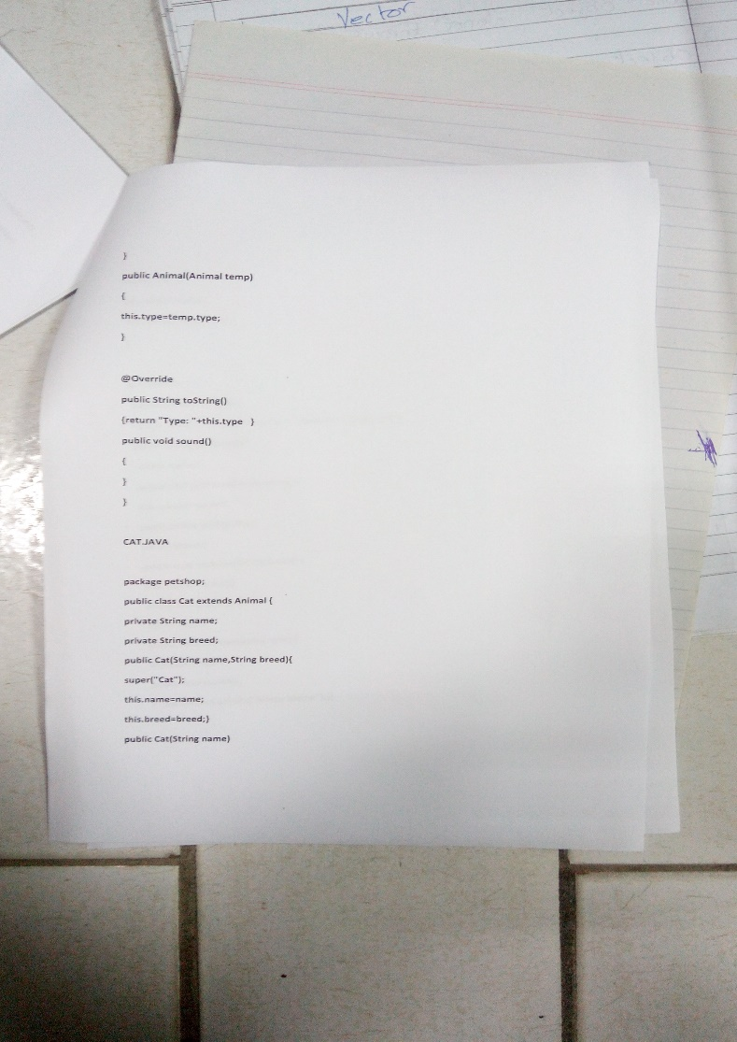
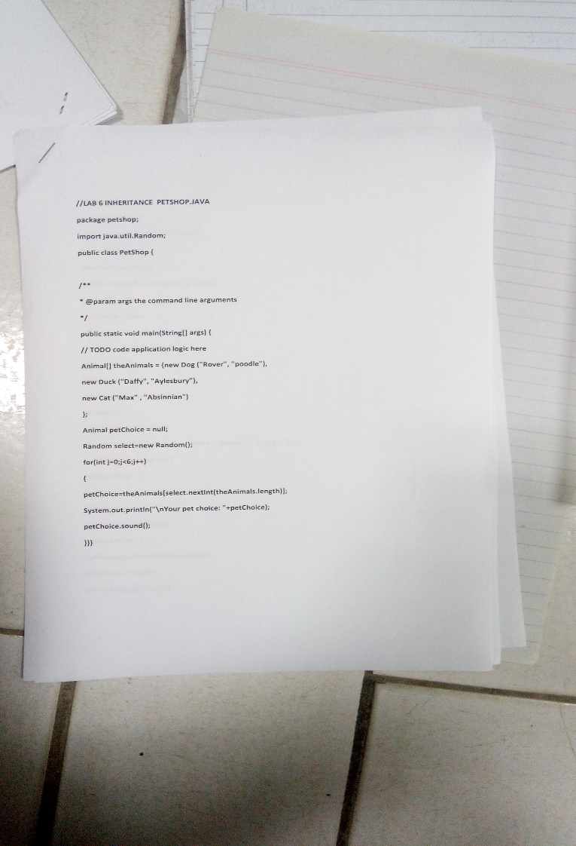
Sample Input

Slide 8
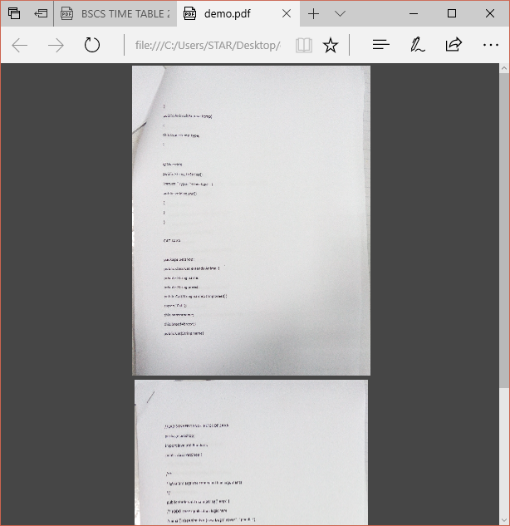

Sample Output

Slide 9
UML Diagrams
In this section we describe Module Wise UML of important classes and UML of relationship between classes.

Slide 10
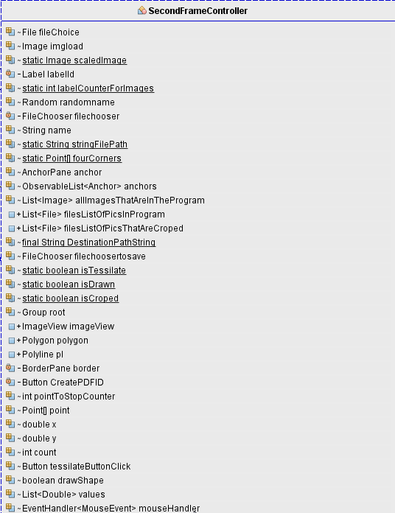
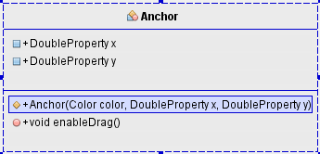
UML for Scanner Module

Slide 11
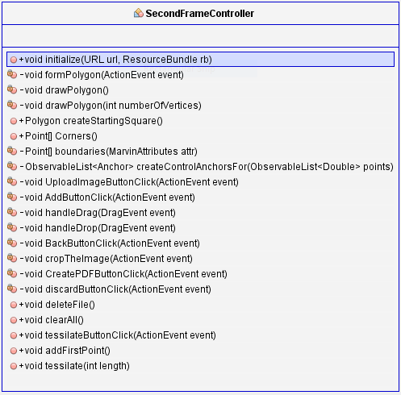
UML for Scanner Module

Slide 12
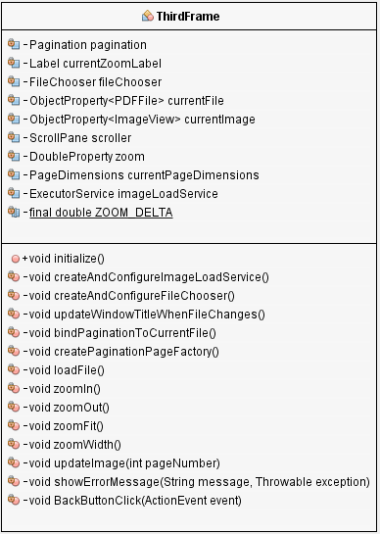
UML for Reader Module

Slide 13
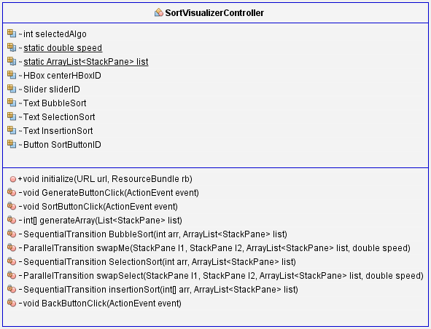
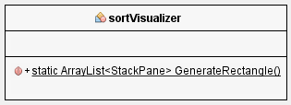
UML for VisualSort Module

Slide 14
Attribute Handling
In this Section we described which attributes are kept private, which are kept static and which are kept final and Why we do so ??

Slide 15
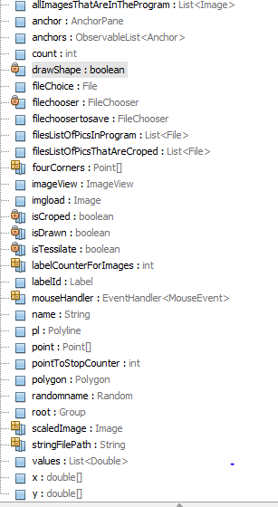
Most of the variable are Public. So they access easy out of the class.
Some of the variable are made private i.e filechooser, isCropped, isTesailate etc. These variable are use for internal process. Changing the values produce malfunction in application
Some variable are declare static. So they are shared among all Methods and work as flags etc.

Slide 16
Constructor calling and function calling
In this section we described how we invoke functions to accomplish certain task. We also talked about parameter passing especially object passing as parameter and object returning from function.

Slide 17
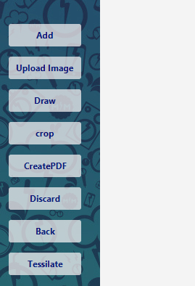
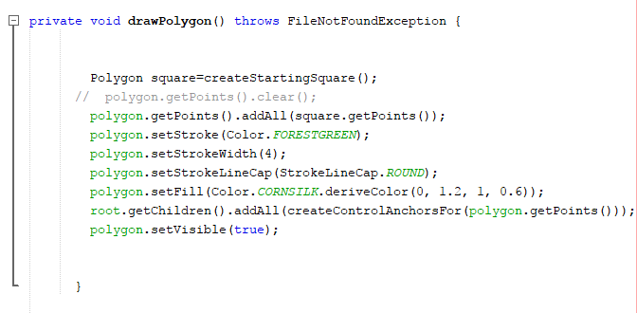
We invoke this function by clicking on Draw button present on the Scanner Application
Screen.
This function is use to Draw a polygon on a image. Internally this function invoke DrawPolygon() function.
1
2

Slide 18
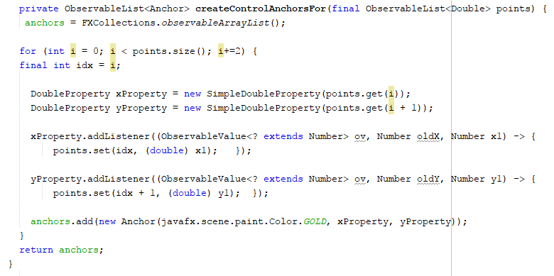
In DrawPolygon() function we are calling another function namely
createControlAnchorsFor().
In this function we passing the Object of (Points of polygon) more precisely
ObservableList<Double> as parameter.

Slide 19
In createControlAnchorsFor(), We are also calling the parameterize constructor of Anchor
Class. That’s take three parameters as Color, DoublePropety X, DoublePropety Y.
After that this function also return the Object of (ObservableList of Anchors).
Checklist:
How Function Invoke.
Object passing as Parameter
Object returning from function
Constructor Calling.

Slide 20
Overloading
In this Section we demonstrate method overloading.

Slide 21
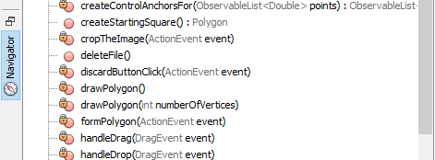
Here we extend the discussion on FormPolygon() method that call another method DrawPolygon() besides that this method also call parameterize DrawPolygon(parameters) .
In this way we achieved method Overloading.

Slide 22
Array of Similar objects
Here we describes the grouping of similar objects via arrays, list and other containers

Slide 23
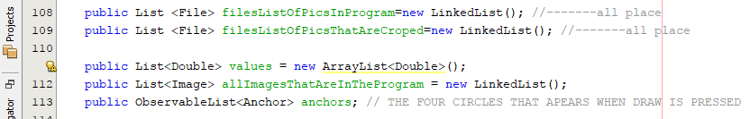
the collection of java i.e ArrayList, LinkedList etc are use to store similar type of Object. We use different List in different scenario.
Here as shown in above snip we used LinkedList , ArrayList and ObservableList in our Application.
In which two LinkedList of file type holds directories of images.
And one LinkedList holds Images. And we use ArrayList to Store Point co-ordinate of Polygons and ObservableList is use to store moveable anchors.

Slide 24
Mathematics, logic , data structure and ai
Here we describe about Mathematics and Logics from Discrete Mathematics domain. It may talk about Algorithms, Matrices, Data Structure, Graph, Tree, Number Theory …………………..

Slide 25
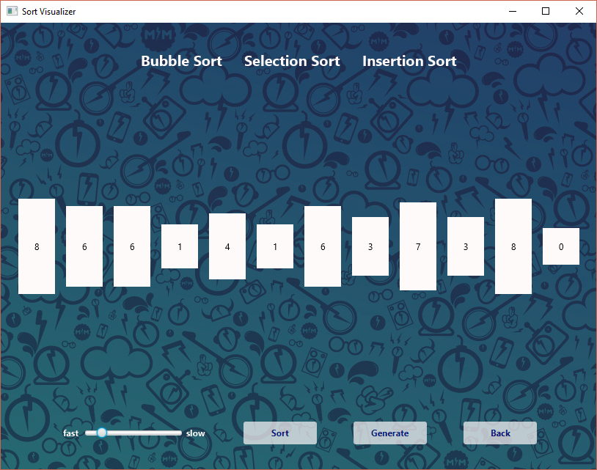
In algorithm section we have whole module on it. In which we visualize the
Bubble Sort, Insertion Sort and Selection sort. And we have different class for Model,
View and Control.
Unsorted
Tiles

Slide 26
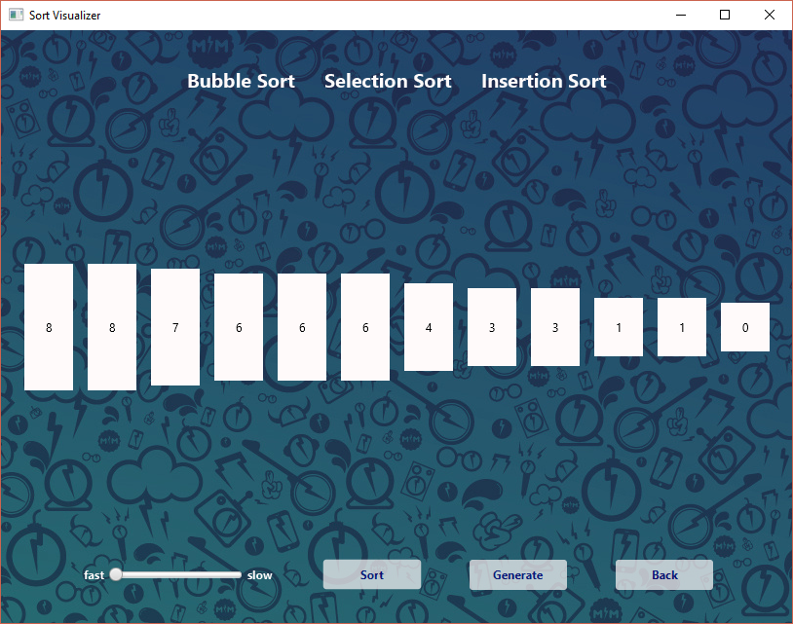
Sorted
Tiles

Slide 27
Sorted
Tiles

Slide 28
Any other content you want to highlight from your project
In this section we describe Our Module / Programming effort which we did as a part of project requirement.

Slide 29
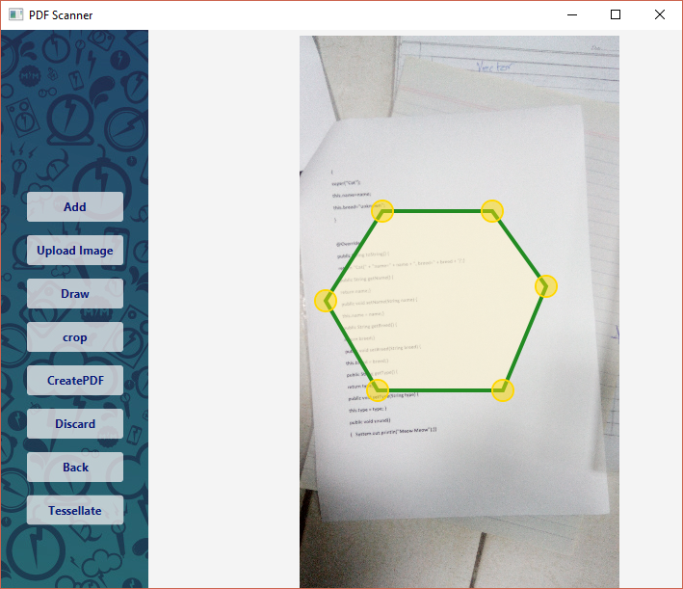
Beside the Sort visualizer we have another section of algorithm in Scanner module
Known as Tessellation/ Triangulation.
In which we visualize the triangulation of polygon
Before
Triangulation

Slide 30
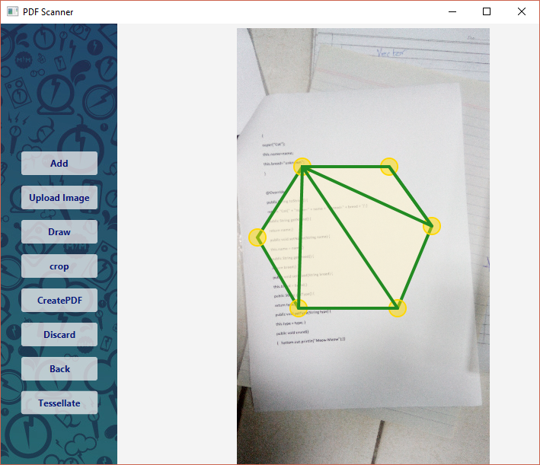
After
Triangulation

Slide 31
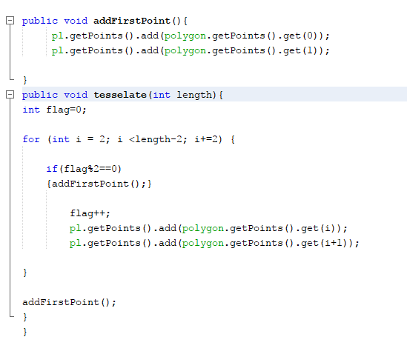
Code

Slide 32
Learning and Achievements
In this section we describe the things that makes us feel that we have learned, we did something new , we did something that is different and thus we should get full marks or even we deserves Bonus marks.

Slide 33
We are glad to say that we have learned the method and technique of java and javaFx.
And Successfully apply on the Project and almost completed the project. And also got some sense of understanding of Computer Graphics.
As far as project concerned that’s definitely different and unique. And required huge Brain effort to accomplished. selecting this daring project and bring it in runnable condition and also achieved flavor of OOP is appealing. That’s why we hope to get full marks and Even Bonus marks

Slide 34
Improvements and future work
In this section we mention the tasks that are still unresolved. The exceptional cases where still improvement is needed. We also mention the applications that can build on top of our current work.

Slide 35
All the task are done except polygon crop. that is impossible at this stage of Knowledge and experience. We handled all type of Exceptions that’s occur during the Development and testing session. We also want to mention that the Advance Pdf Scanner and reader can be build on our Application using knowledge of Computer Graphics.

Slide 36
Demo and Queries
We are attaching a demo video of the Application
We are available for queries anytime…

